Slide 1
Mobile Test Automation
By Dimple Sharma
June 2016

Slide 2
Mobile Apps Test Automation using Appium
What is Appium :
Open Source ,Cross platform test automation tool
For Native ,hybrid and Mobile web apps
Works on emulator, simulator and Real devices
Extended form of selenium 2
Why Appium:
No Need to modify or recompile the code.
Use Any testing frameworks
Any language: in total 7 like Java, Ruby, php ,JavaScript and Python.
Platforms : iOS and Android and Firefox OS

Slide 3
TestNG:
For Running many test cases at one Trigger
Execution cab be performed on class level as well as on Package level
Regular expression
Maven:
Build Management tool
For Creating Project Hierarchy or a Framework
It takes care of required jar files
Jenkins CI tool:
For Build Scheduling
Logs
reporting

Slide 4






Workflow of Appium automation using Java(Maven Framework)
Develop
Manage
Build and Test
Appium Server
StartAppiumServer.bat
Java IDE
GitHub
Jenkins
code check-in
pom.xml
Maven
TestNG.xml
TestNG

Slide 5
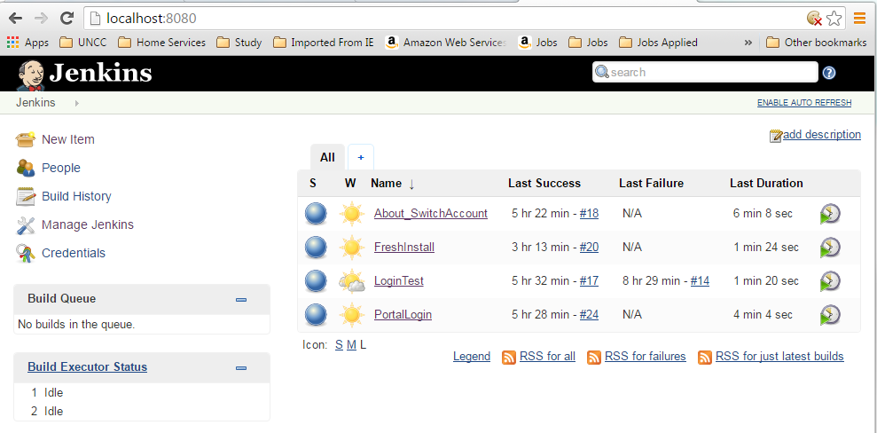
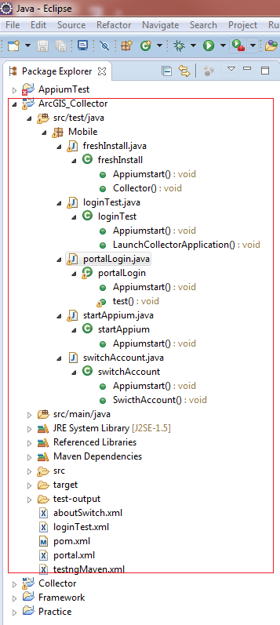
Builds Scheduled in Jenkins Based on Profiles

Slide 6
Links to automation Demo
\\akhullar\public\download\mobile\Collector\Automation Video
Covers below Basic test cases :
Install the current Build on the device
Start the application after installing is over
Check Learn More page
Check Try Collector
Continue sign In to http://www.argis.com with incorrect credentials
Sign in with correct credentials check error message
go to right side Browse panel and select Switch Account--> check messages/prompts
Shutdown the app while signed in and check that credentials are remembered on next launch
Check the count of Maps in 'All Maps' tab
Open Maps from 'All Maps'
Check if all groups have loaded in browse panel list.
Check the map count in my maps & other groups to verify if we are pulling the correct maps count or not
Open the contents from my maps & other groups
Check About Page (Build#, Version, Links)

Slide 7
Below Softwares for End to End Automation environment Setup All Free ☺
Java
Eclipse
Selenium Jars
Java clients jar
Appium Server
node JS
Android SDK
Microsoft .net
Driver software/ Which will install all missing software Automatically.
TestNG
Maven
Jenkins Tool
Device
APK file

Slide 8
Thank You ! Suggestions and Questions are Welcome ☺

